Slide 1
Digital Electronics Crash course – day 2 Lab
23-AUG-2018
Abhimanyu Arora
Koh Yi Min Jason

Slide 2
multivibrator astable

Slide 3
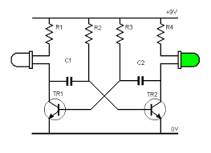
multivibrator astable
MULTIVIBRATOR ASTABLE In this lab activity, we will connect up the circuit called a multi-vibrator astable as shown below.

Slide 4
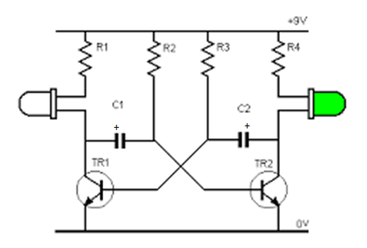
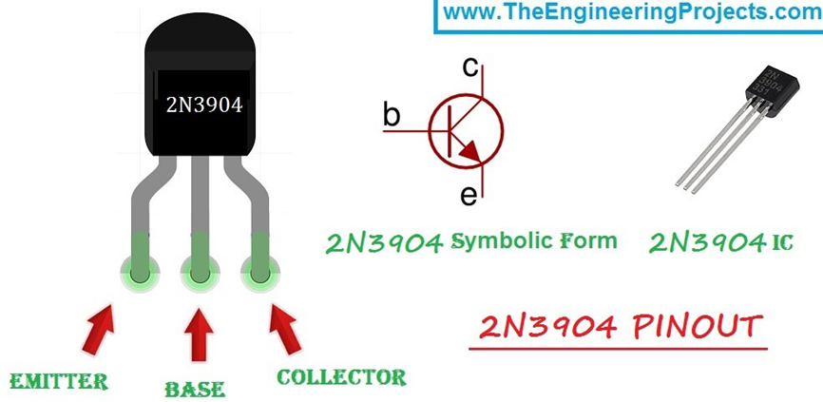
Lab activity 1
Connect the circuit as shown below
NOTE
You can use any capacitor and resistor value but
R1 must be equal to R4
R2 must be equal to R3
C1 must be equal to C2
2N3904 Pin layout

Slide 5
D flip-flop state machine with 1 input

Slide 6
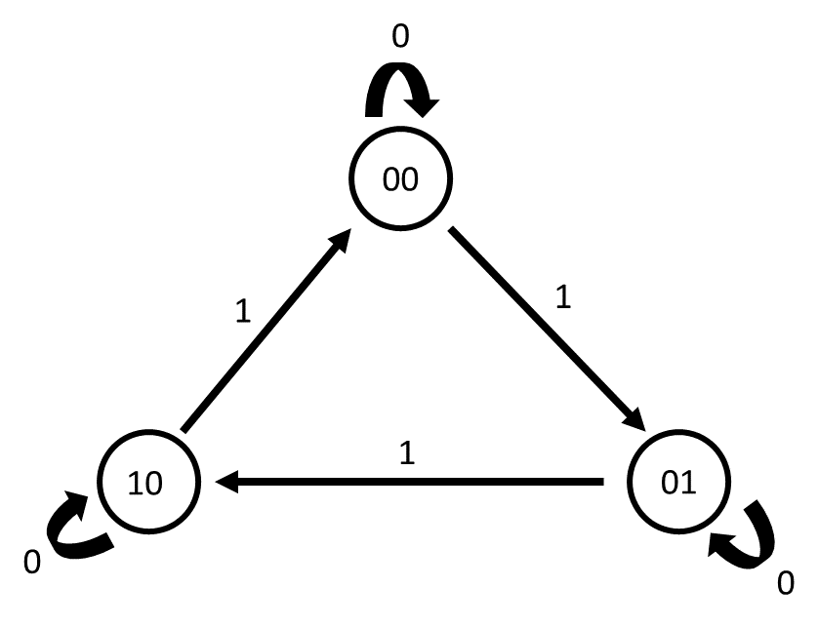


D flip-flop state machine
D Flip-Flop State machine with 1 input In this lab activity, we will connect up the circuit for example 2 of D Flip-Flop State machine
State Diagram
Boolean expression for D₀ and D₁
$D$₀ = Q₀$\overline{X}$ + $\overline{Q}$₁$\overline{Q}$₀ X
$D$₁ = Q₀X + Q₁$\overline{X}$

Slide 7
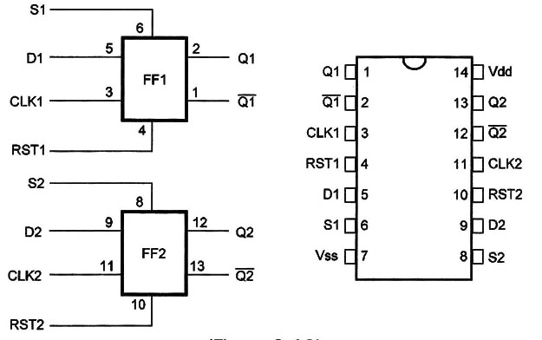
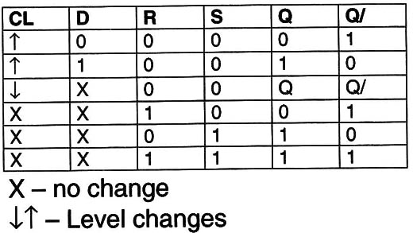
D flip-flop state machine
4013 Dual D-flip flop The 4013 IC is an IC that has 2 D-flip flops. For normal D-flip flop operation, the SET (S) and RESET (RST) have to set to LOW
Ensure that Vdd (Pin 14) is connect to the positive power supply and Vss (Pin 7) is connected to GND
4013 Pin layout and internal
4013 Truth table

Slide 8
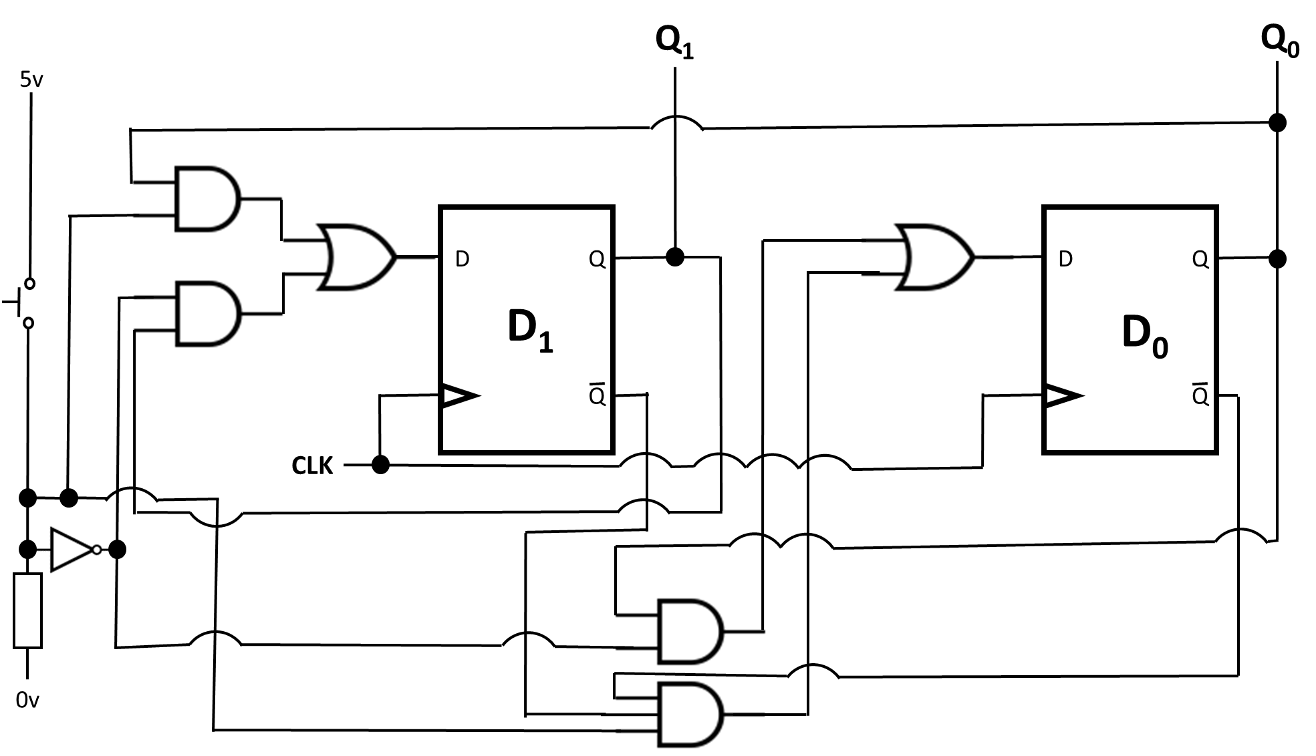


Lap activity 2
Connect up the circuit as shown
Boolean expression for D₀ and D₁
$D$₀ = Q₀$\overline{X}$ + $\overline{Q}$₁$\overline{Q}$₀ X
$D$₁ = Q₀X + Q₁$\overline{X}$

Slide 9
Multiplexer/de-multiplexer

Slide 10
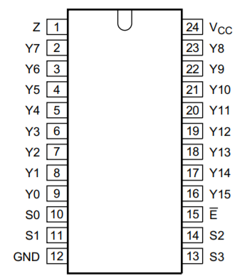
Multiplexer/de-multiplexer
4067 Multiplexer/De-multiplexer (1-of-16 switch)
Z is the common link of the multiplexer/de-multiplexer Y0 to Y15 are inputs/output of the multiplexer/de-multiplexer.
S0 to S3 is the address select inputs
For normal operation, Pin 15 (E) is to be set to LOW.
Ensure that Vcc (Pin 24) is connected to the positive power supply and GND (Pin 12) is connected to GND or 0V
4067 pin layout

Slide 11
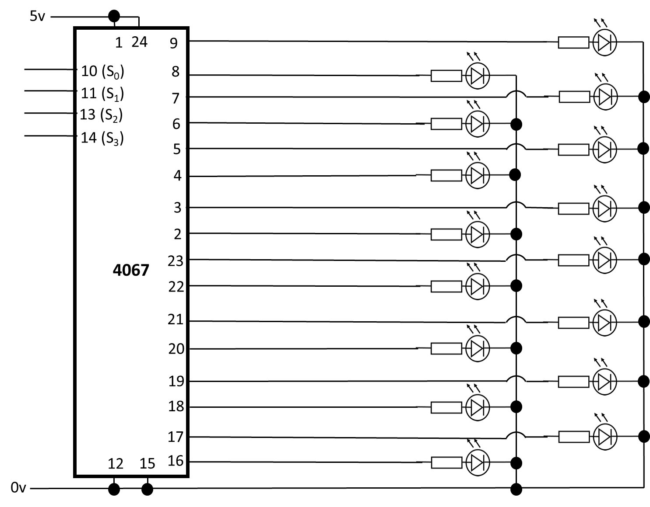
Lab activity 3
Connect the circuit as shown
For S₀ to S₃ try different combinations

Slide 12
4017 decade counter

Slide 13
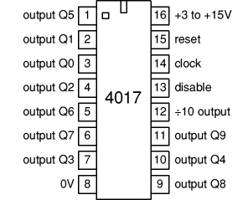
4017 decade counter
4017 decade/Johnson counter
For normal operation, Pin 15 (E) is to be set to LOW.
Ensure that Pin 16 is connected to the positive power supply and Pin 8 is connected to GND or 0V
4017 pin layout

Slide 14
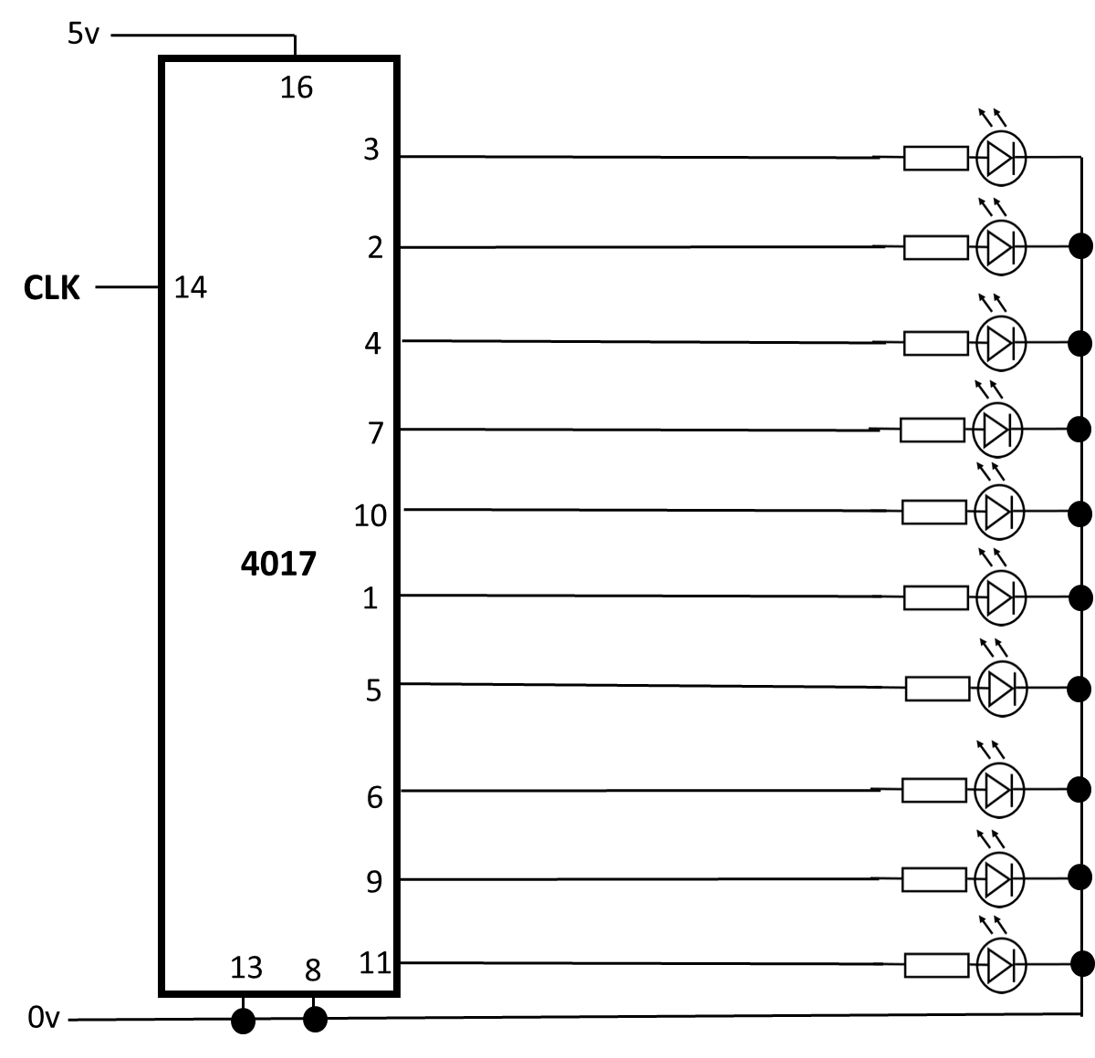
Lab activity 4
Connect the circuit as shown

Slide 15
4040 12-bit (÷4096) ripper counter

Slide 16
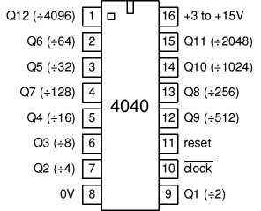
4040 12-bit (÷4096) ripper counter
4040 12-bit (÷4096) ripper counter
For normal operation, Pin 11 (reset) is to be set to LOW.
Ensure that Pin 16 is connected to the positive power supply and Pin 8 is connected to GND or 0V
4040 pin layout

Slide 17
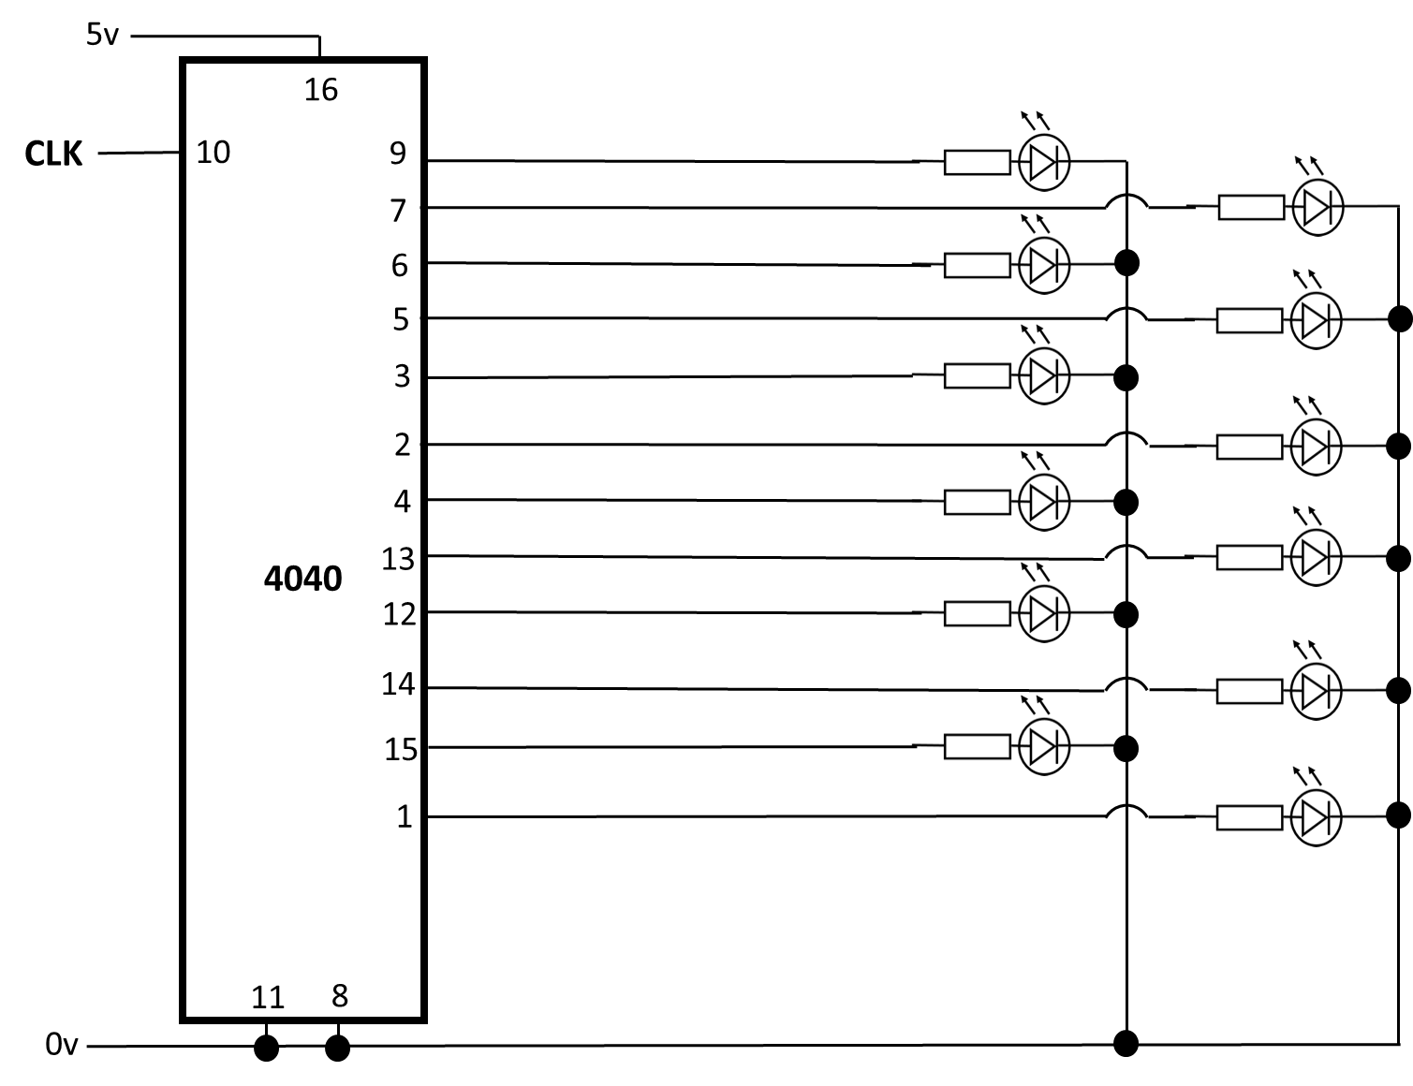
Lab activity 5
Connect the circuit as shown

Slide 18
The END

Slide 19
Comparator

Slide 20
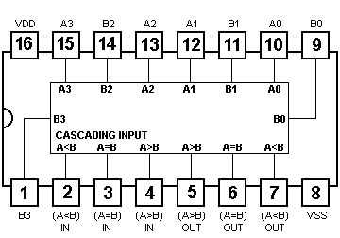
Comparator
4063 4 bits comparator
For normal operation, Pin 3 is to be set HIGH and Pin 2 and Pin 4 is to be set LOW.
Ensure that Vdd (Pin 16) is connected to the positive power supply and Vss (Pin 8) is connected to GND
4063 pin layout and internal

Slide 21
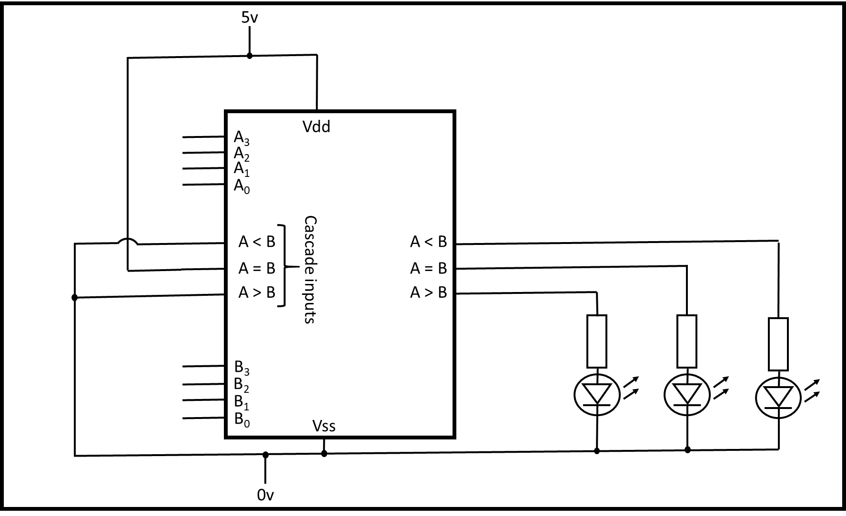
Lab Activity 2
Connect the circuit as shown below as such
After you connect up the circuit, you can try different combinations at the Inputs A₃ to A₀ and inputs B₃ to B₀
4063 pin layout and internal

Slide 22
7-Segment display and 4511 decoder

Slide 23
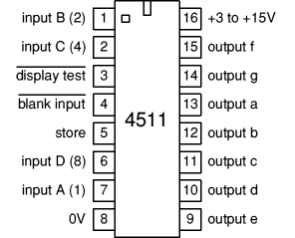
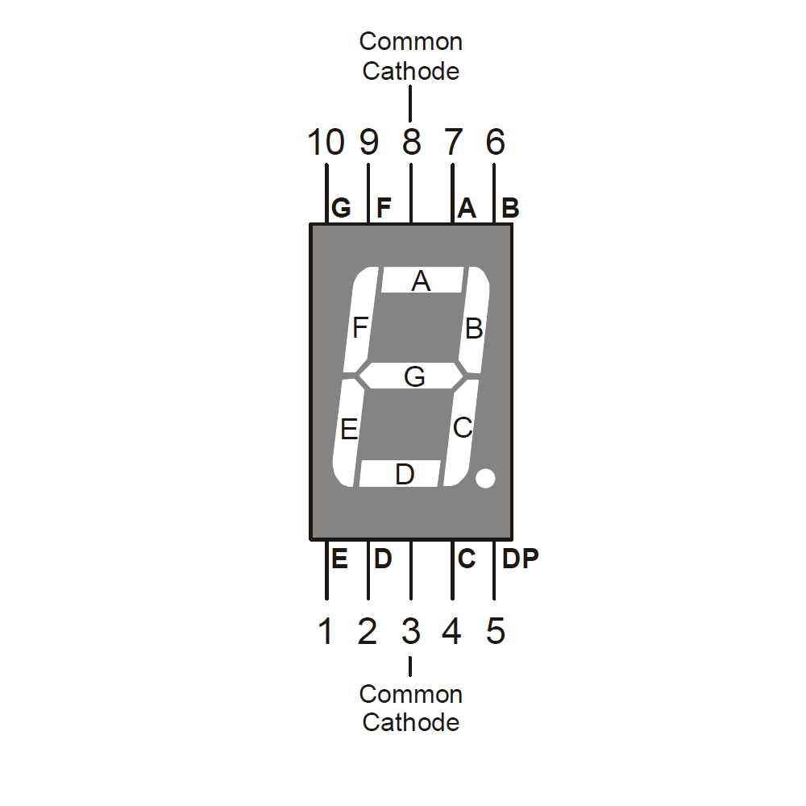
7-Segment display and 4511 decoder
4511 pin layout
4511 7-segment display decoder
For 4511 IC normal operation, Pin 3 (display test) and Pin 4 (black input) is to be set HIGH. Pin 5 (store) is to be set LOW.
Ensure that Vdd (Pin 16) is connected to the positive power supply and Vss (Pin 8) is connected to GND
7 Segment display Common Cathode layout

Slide 24
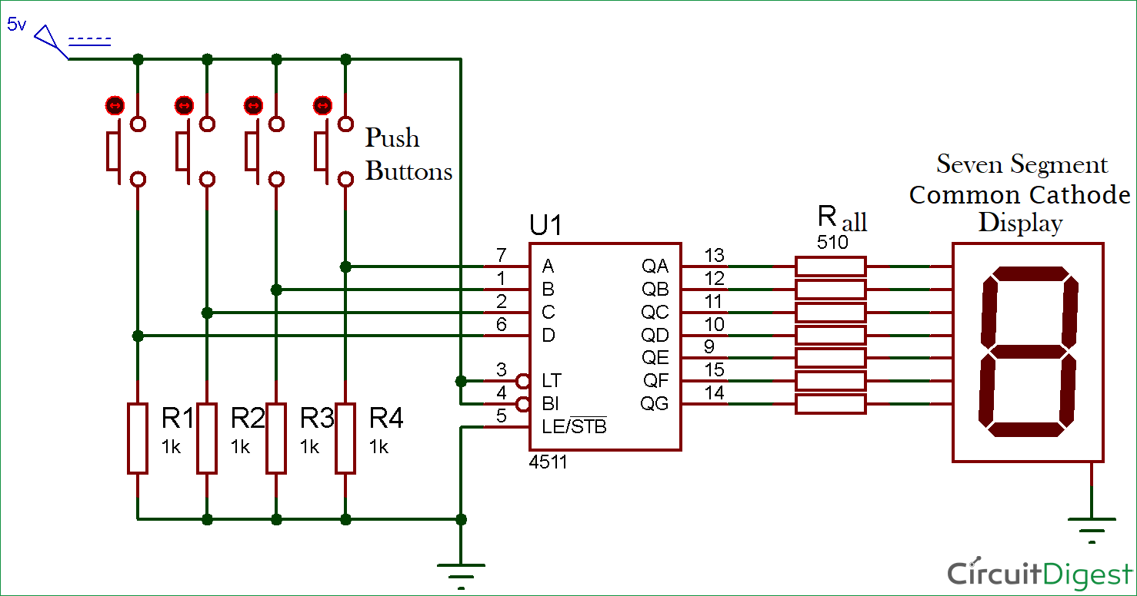
Lab Activity 3
Connect the circuit as shown below as such

